Slide 1
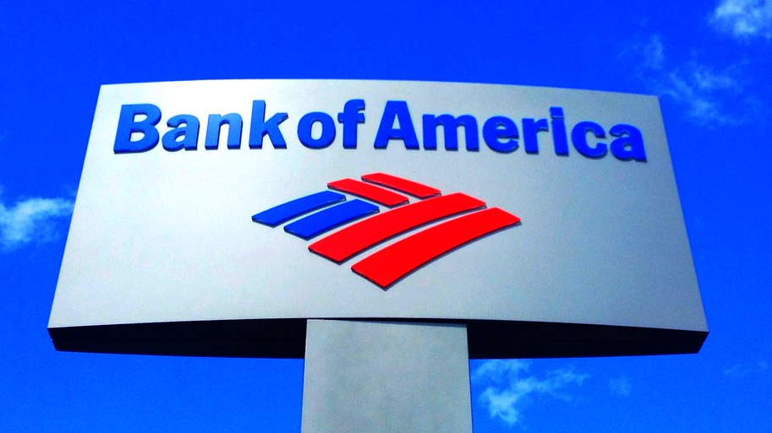
bank of America
This Photo by Unknown Author is licensed under CC BY

Slide 2
Agenda slide
Description of the organization
Summary of key strengths and weaknesses
Opportunities for the organization (Economic value, social values and environmental values).
Recommendation for effective pursuit of value proposition
Conclusion

Slide 3
The organization
Bank of America is an American banking institution serving as an investment bank and financial services holding company.
The bank is currently considered the second-largest banking facility in the US, and consequently ranks the eight largest bank globally.
In the United States today, the bank has an observably significant customer base, serving an approximate of 11% of all bank deposits (Bank of America, 2021).
The bank serves a wide variety of customers including individual customers, SMEs and large corporations offering investing, asset management, and risk management of products.
The company has active operations in over 35 countries globally besides establishing a strong foothold in the American banking industry particularly as a lending as a financial institution.
Notes:
Bank of America is among the leading firms within its industry.
The bank is an American multinational investment bank and financial services holding company headquartered in Charlotte, North Carolina. The bank currently customers in over 35 countries globally, controlling over 11% of the American banking industry.

Slide 4
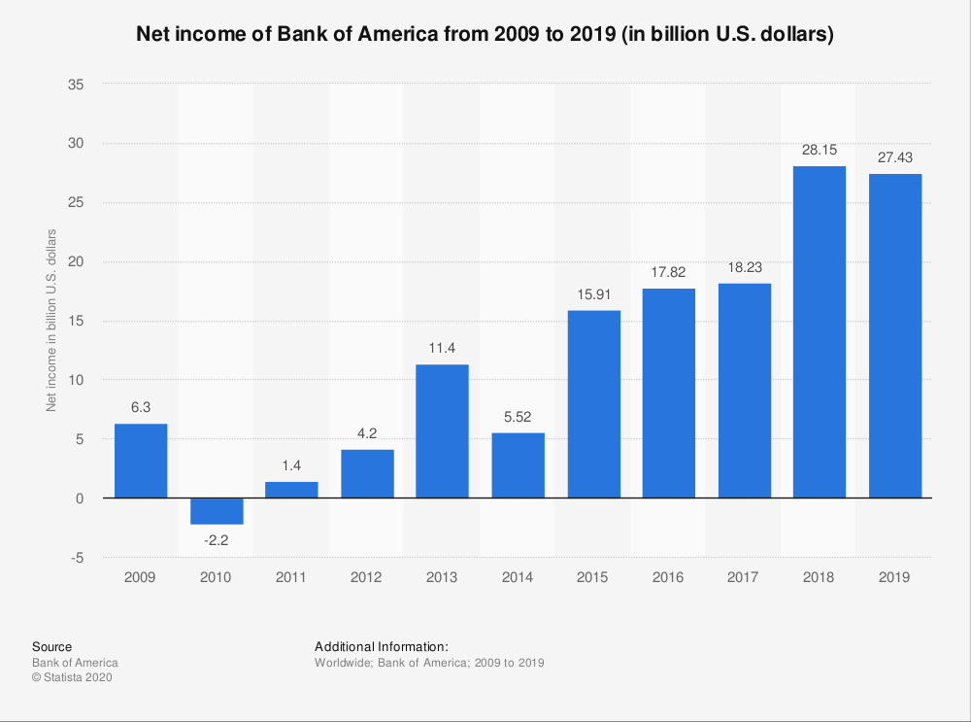
The bank of America: net income

Slide 5
Summary of the strengths
Company presence and brand image
Structure and organization
Mode of operations
Notes:
Bank of America is a brand that has been in the market for years, and people are aware of it. This makes its brand awareness high.
Its products have maintained quality over the years and are still valued by customers, who find it as good value for the amount of money that they pay.
Bank of America has active operations in over 35 countries worldwide besides a customer base of over 46 million customers.
In this view, the company has acquired considerably enormous net income.
Bank of America arguably has an efficient structure and has been able to acquire many banks such as Merrill Lynch in 2008, an acquisition that enhanced the company’s status in wealth management.
The bank does not only engage in international banking services but is also fully engrossed in small business banking in the United States to consequently establish an admirable footprint in the commercial banking and local lending services.

Slide 6
Cont..
Training of employees
Online banking
Notes:
Bank of America has invested extensively in the training of its employees that has resulted in it employing a large number of skilled and motivated employees.
Bank of America has a well-established IT system that ensures efficiency in its internal and external operations.
The company spend huge sums of money to ensure that their employees are well trained.
With approximate employee base of 208,000 employees, employees have remained a key strength for the company.
Efficient online banking services such as net banking and investments have ensured that the company retains its customer base.

Slide 7
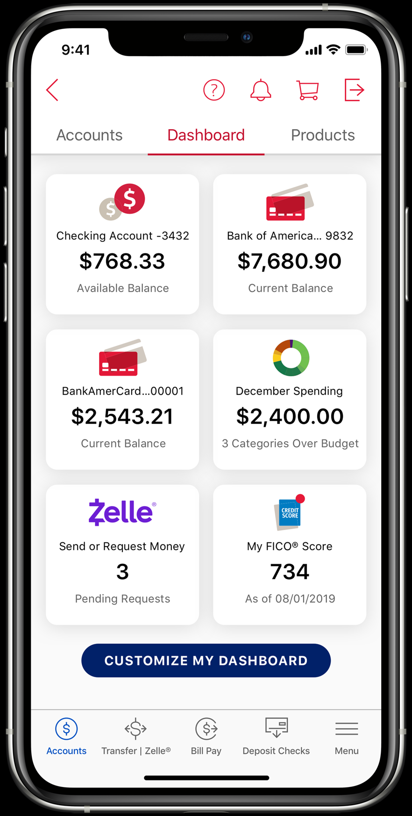
ONLINE BANKING FEATURES AND BENEFITS

Slide 8
Weaknesses
Dented company image
Overdependence on the American market
Cost cutting and layoffs
Notes:
Dented public due to continued controversies. The Wikileaks controversies of 2010 and 2011 gave a bad impression of the company particularly in the face of investors. The company has witnessed declining public reputation due to controversies. The Wikileaks controversy for instance, resulted in negative public image particularly in the face of investors.
The bank heavily depends on the American market generating over 90% of the total revenues. High bank charges significantly limits international investment. Even though the company operates in more than 35 countries globally, it has not been able to obtain much revenue from the international franchises. This has resulted the overdependence on the American market.
The bank over the past three years has depended so much on cost cuttings and employee layoffs which have continued taint the company’s brand image. As a measure to avoid incurring huge losses, the CEO indicated that sending away some employees is an essential strategy to reduce the company’s expenditures. Bank of America seems to depend so much on cost cuttings and layoffs as strategy to avoid incurring losses.

Slide 9
Opportunities
Partnership
Strategic partnership also provides an opportunity for the company.
Giving discounts and cash rewards to the customers
Technology
Enhancing its capacity in internet-based banking.
Arguably, this is an opportunity for the bank to their innovations and services available in these countries.
Notes:
Strategic partnerships are established by Bank of America with its suppliers, dealers, retailers and other stakeholders. This allows it to leverage them if need be in the future. Believably, entering into partnership deals with online retail giants such as Amazon would give the company an advantage over its competitors.
It is noted that the company has had very long history of engagement in online banking. For this reason, internet-based banking operations takin over the world currently gives the company a chance to improve on its revenues generation.
There has been a new trend and a growth in sales of the e-commerce industry. This means that a lot of people are now making purchases online

Slide 10
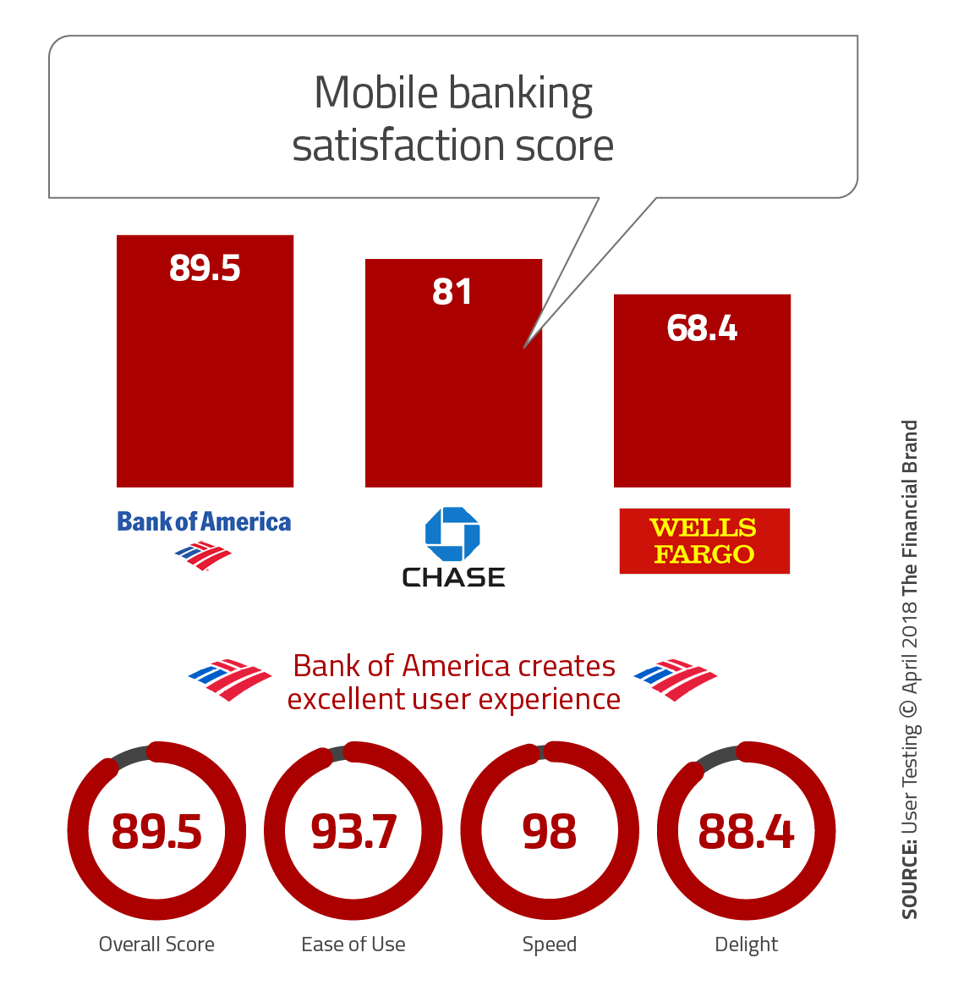
Bank of America creates excellent user online experience

Slide 11
Opportunities for economic value
Acquisition
Engaging in largescale acquisition of other banks outside the US.
Global image
It is evident that the controversies such as the Wikileaks 2010 and 2011 only dented the company’s image locally.
Global largescale expansion due to its already established global footprint.
Notes:
Through acquisitions, the bank can enter into new markets outside the US.
Growth through market penetration in international banking/financial services operations
High value of Bank of America brand is also an opportunity to enhance its economic value.

Slide 12
Cont..
As observed by Lesley (2019), there is still a huge market potential in the US which has not been fully utilized.
In this view, local expansion by the company would do better to increase its revenues.
Observably, this would also enhance in its competitiveness compared to that of the other competitors.
With a considerably stable income in the US, the bank observably has the ability to engage in new technology investments as well as new product segments.
Believably such diversification strategies would ensure business growth besides reducing risks.

Slide 13
Opportunities for social value
Bank of America can engage in essential practices such as reducing the bank charges for the international customers.
Observably, the presumably high bank charges have been the leading limiting factor for international operations.
The local revenues realized by the bank in the United States are observably high as depicted in the company’s annual returns (Fern Fort University, 2021).
Engaging in humanitarian issues would be a better strategy to redeem the bank’s dented public image.
Notes:
To maintain its popularity among the customers in the banking sector, the bank can reduce the charges for their international customers.
It is also argued that the revenues obtained in the American market is observably high and the bank can use the revenue to engage in humanitarian issues which would believably help in redeeming the bank’s dented public image.

Slide 14
Opportunities for environmental value
Enhancing the use of technology by the company can be seen as an essential strategy to reduce the overall paperwork.
Similarly, as a form of social responsibility, the company may also engage in certain activities of environmental conservation.
Notes:
Environmentally social companies always receive government support when required. The bank can engage in strategies to reduce the overall paperwork at the facility.
Also, taking part or supporting environmental protection actions would also be considered important opportunities to enhance its environmental value.

Slide 15
Recommendation
Enhanced investment in credit cards
It is recommended that the company should engage in sustainable growth that is particularly customer-focused.
The analysis of the external environment has revealed a global shift towards virtual technology in the banking industry.
In this view, it is essential to understand that the company already has a strong footprint in credit cards operations (Wolters, 2000).
To ensure the establishment of an efficient wealth management franchise globally, the company must focus not only it its digital and mobile platforms, but also ensure an increased access to credit cards in the countries outside the US.
On their part, this would believably deliver solid and recurring profitability with improved cash flow and possible investment for the future by their customers.
Notes:
With an observably strong footprint in credit cards operations, this is the area in which the company needs to focus on to stay ahead of their competitor in the market.
Increased access to credit card facilities for their customers would be in line with the global shift towards virtual technology in banking.

Slide 16
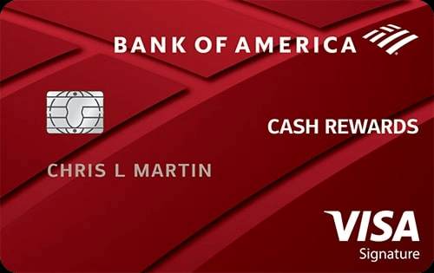
Bank of America: increased access to credit cards

Slide 17
Conclusion
Based on this presentation, the bank of America is a multinational bank with retail centers scattered across the world.
The bank is the second largest bank in the United States controlling up to 11% of the country’s total bank deposits.
The company engages in financial investments, lending and asset management globally.
The observably enormous company brand is the leading strength of the company.
Acquisitions and mergers have also played significant roles in maintaining the financial strength of the company.
Through the rapid adoption of new technology, the company has been able to successfully tap into the foreign markets ahead of its competitors.

Slide 18
References
• Bank of America. About Us. Retrieved from: https://www.bankofamerica.com/
• Lesley White. (2019). Bank of America SWOT Analysis (Internal & External Strategic Factors). Retrieved from: https://www.rancord.org/bank-of-america-swot-analysis-internal-external-strategic-factors
• Fern Fort University. Bank of America SWOT Analysis / Matrix. Retrieved from: http://fernfortuniversity.com/term-papers/swot/1433/1021-bank-of-america.php
• Wolters, T. (2000). " Carry your credit in your pocket": The early history of the credit card at Bank of America and Chase Manhattan. Enterprise & Society, 315-354.

